Slide 1
X-Ray Classification
By: X-Ray Vision
Hossam Zaki, Mohamad Abouelafia, Isaac Nathoo, Muhammad Haider Asif

Slide 2
Motivation
In order to assist doctors with classifying over a thousand of x-rays a day, we designed a model to classify different pulmonary diseases and conditions (Atelectasis, Hernia, Edema)
We also would like to tackle the problem of doctor error.
We also used COVID-19 X-Rays to see if our model could accurately classify COVID-19 X-Rays as well
Notes:
hos

Slide 3
Data
For our X-Ray images, we used the NIH Chest X-Ray dataset
Over ½ of the dataset was “No Finding”. We will touch upon this later
For our COVID-19 images, we found a dataset on kaggle
Notes:
hos

Slide 4
Goal
Build a model to accurately predict conditions based on X-Ray images
Test out different pre-processing methods
Test existing models with our data
Notes:
mo

Slide 5
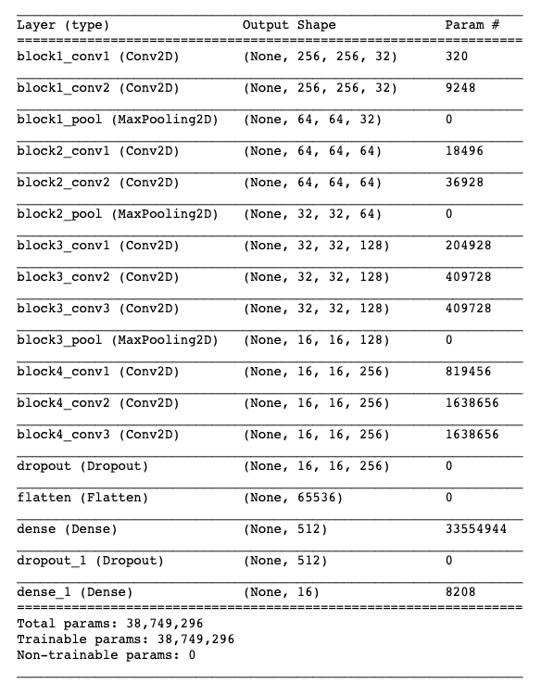
Architecture
Notes:
mo

Slide 6
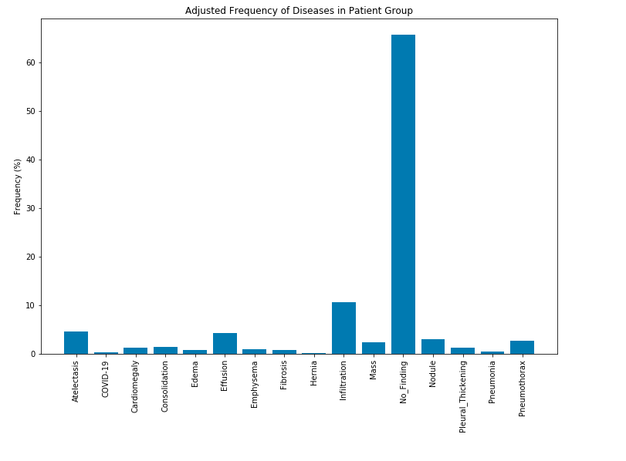
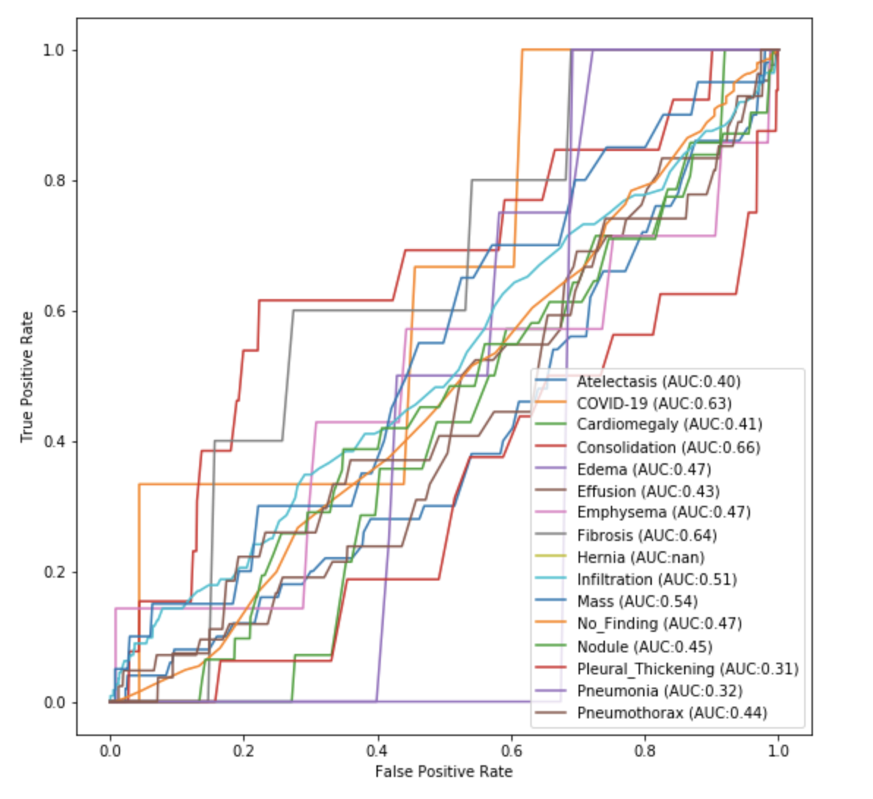
Results (including No Finding)
After one epoch
Notes:
hos

Slide 7
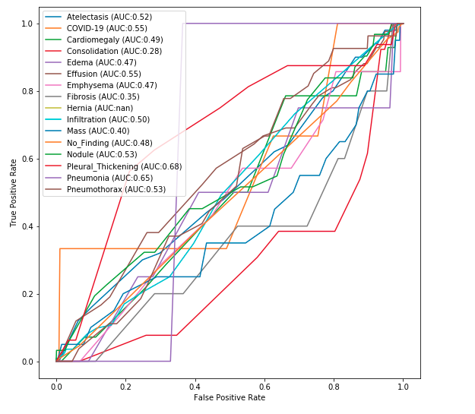
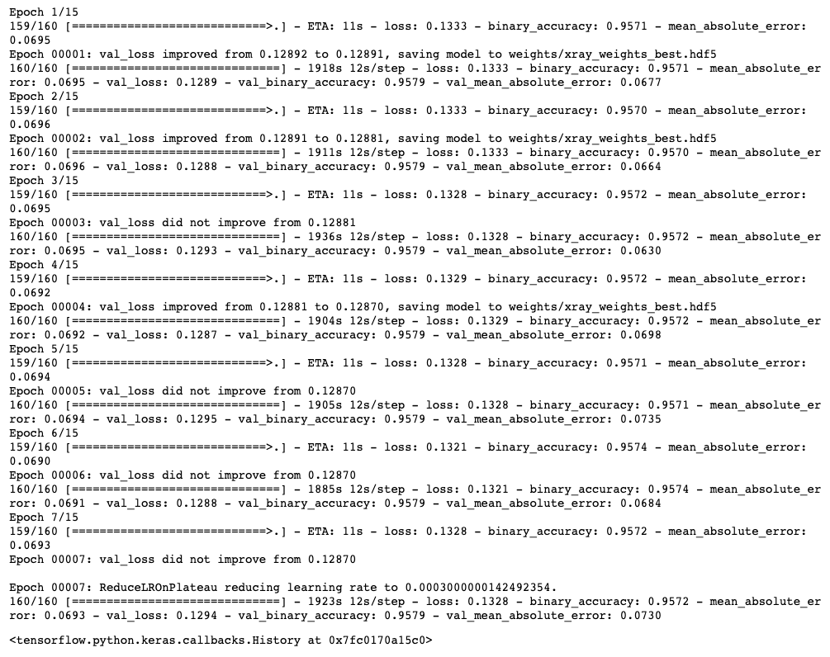
Results (including No Finding)
After 7 epoch’s
Notes:
hos

Slide 8
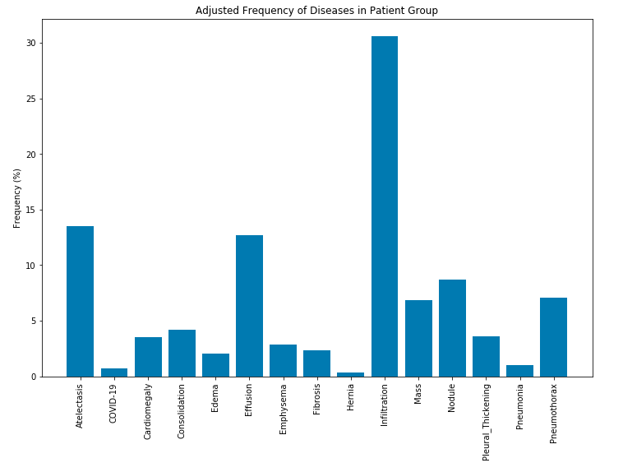
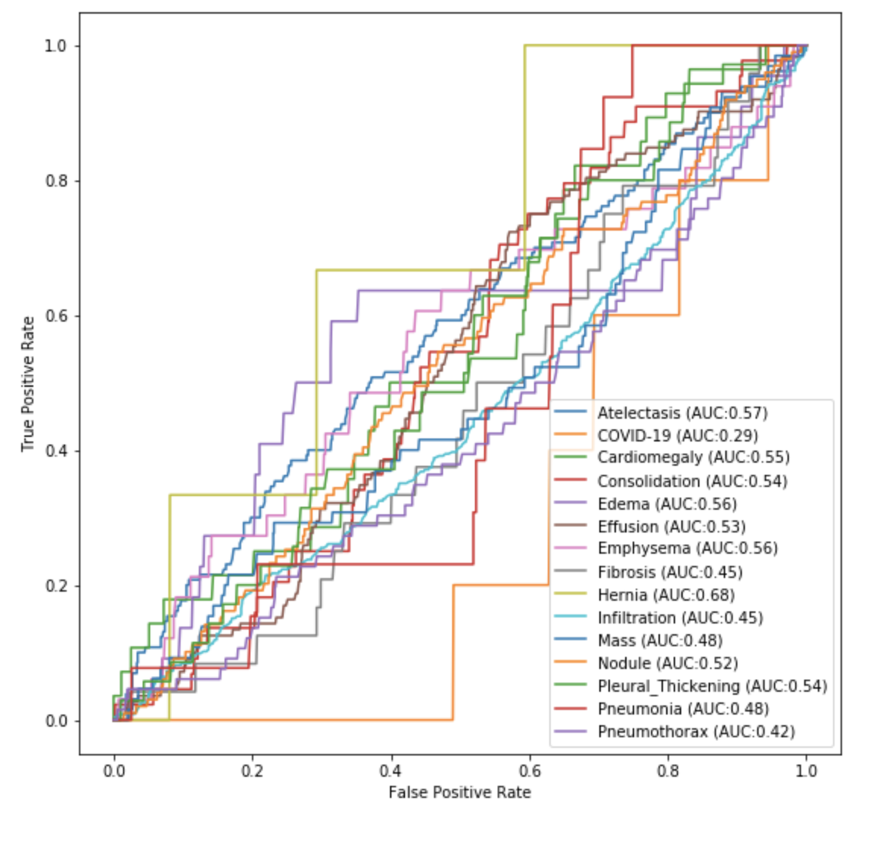
Results (Excluding No Finding)
After one epoch
Notes:
mo

Slide 9
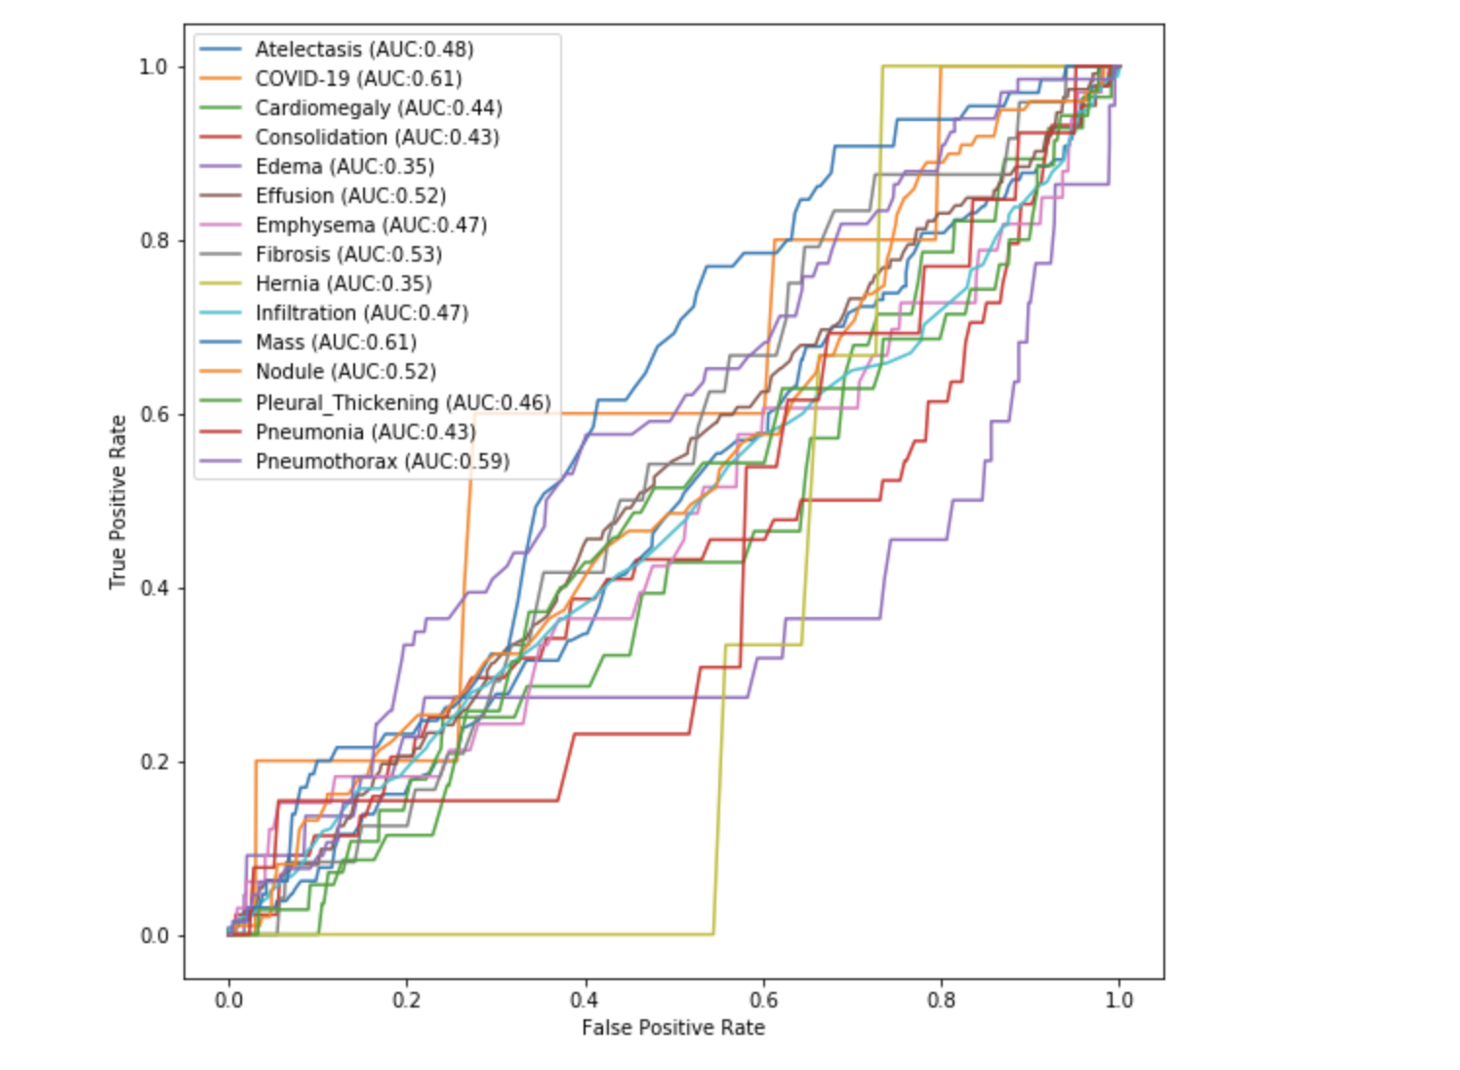
Results (Excluding No Finding)
Notes:
mo

Slide 10
Next Steps
We would like to compare our model with higher end and more established models such as ResNet, and see how our model compares
Beyond the class, we hope to expand upon our currently designed model. We would also like to improve our preprocessing to get better quality images and build a more balanced dataset
Notes:
mo

